Slide 1






Partnering for the future of education

Slide 2



Technical skills are more important than ever
By 2022, there will be 6.2 million job openings in cloud-based technology*
Employers are struggling to find employees with the right technical skills to meet their organizational objectives
Today’s students want more than a diploma—they want real-world skills that make them employable from the onset
Departments and faculty want the right resources to deliver innovative technical courses in order to meet their students’ needs
Employers highly value graduates who have their degree plus an industry-recognized certification**
*US Bureau of Labor Statistics
**MarketScale

Slide 3
Opportunities for educators

Slide 4

Microsoft Learn for Educators
Deliver cutting-edge tech instruction to students with confidence
Microsoft Learn for Educators provides institutions and educational non-profits with comprehensive resources to enable innovative technology education. Participating institutions and faculty gain access to Microsoft curriculum and teaching materials to easily offer in-demand content to students, while providing opportunities to earn industry-recognized certifications.
Teach tech skills for the future
Build students' technical skills with curriculum, educational materials, and tools provided by Microsoft.
Gear up for course delivery
Get access to training and tools that prepare faculty to deliver cutting-edge technical instruction.
Make an impact in students’ lives
Become a part of a global faculty community helping to prepare students for future careers.
aka.ms/MSLE

Slide 5
Microsoft Learn for Educators
Supporting tech skills education across the globe
Available in over 85 countries in 12 languages
Training and certifying 111,182 students with industry-recognized skills
Supporting 420 institutions to offer best-in-class technical curriculum
Giving 3,773 educators training, technology, and tools to prepare students
Last updated 2.15.22

Slide 6
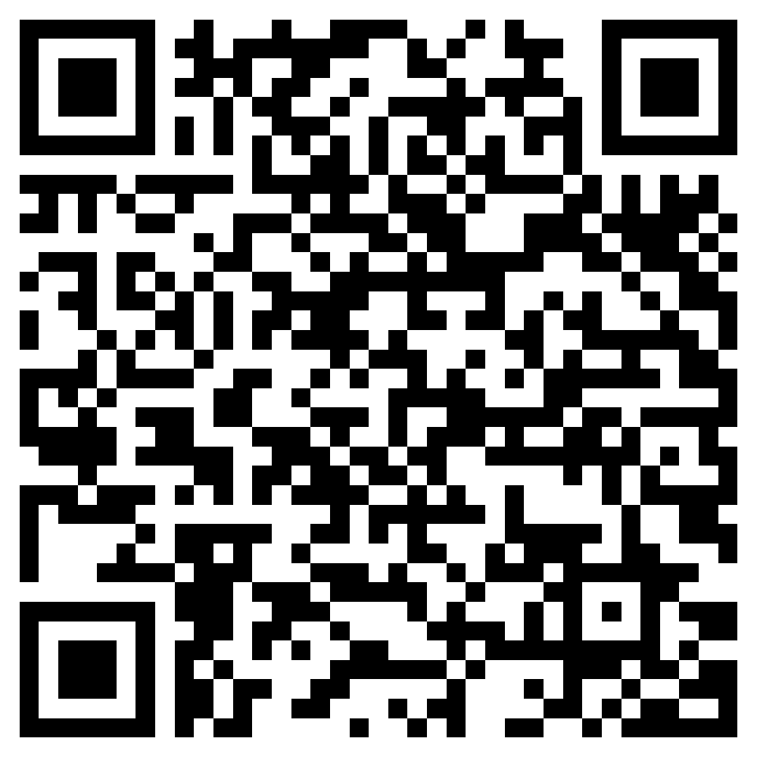

Get started today
Microsoft Learn for Educators
Build students’ technical skills while establishing a relationship with Microsoft
5
4
Prepare students with industry-recognized certifications.
3
Integrate curriculum and start teaching, training, and skilling your students.
2
Onboard and work with your Microsoft training program manager to access your materials, training, and certification voucher.
1
Apply to Microsoft Learn for Educators at http://aka.ms/MSLEInstitutionApply
Are you an Individual Educator? Sign up at http://aka.ms/MSLEEducatorSignUp
Identify a Program Advisor who acts as primary point of contact with Microsoft.

Slide 7
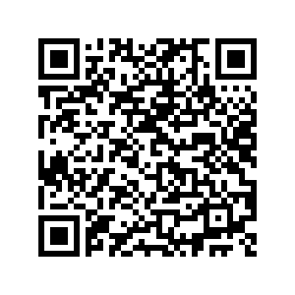
Azure Dev Tools for teaching
Azure Dev Tools for Teaching gives university students access to download more than 100 Microsoft Developer Tools, plus easy access for students to redeem Azure for Students.
STUDENT ID CARD
Option to redeem Azure for Students offer
100+ Free Developer Tools
Library of
Learning Paths
University Purchase
Student Access
OUTSIDE THE CLASSROOM
STEM Students wanting to learn on their own, participate in hackathons, or build their Imagine Cup project can access dev tools that simplify their journey.
INSIDE THE CLASSROOM
Available to all STEM courses, Azure Dev Tools for Teaching provides the tools needed (such as IDE) for students to learn and complete projects
USAGE SCENARIOS
Notes:
Free to customers with an EES agreement or can be purchased at $499 annually
Access to tools commonly used for STEM programmes including professional developer and designer tools, software and services that professors can use for their students and provide access to
Visual Studio and Integrated development environment
Azure Lab Services – tool to enable educators to set up and provide on demand access to preconfigured VMs to support classroom scenarios.

Slide 8
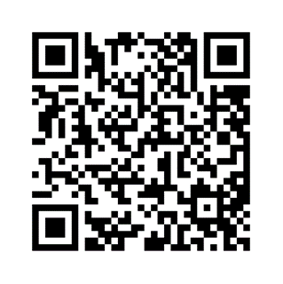





Azure Lab Services
A tool to set up and provide on-demand access to preconfigured virtual machines (VMs) to support classroom scenarios in Higher Education. Teach a class, train professionals, run a hackathon or a hands-on lab, and more. By defining requirements the service will roll the lab out to the agreed audience.
Faculty staff can create labs and support their classes without IT intervention
Provides lab resources to students in any location from any device
All inclusive pricing model
Define availability of lab resources to only pay for what is used
Set up from one cloud based PC with all the software and files needed for the class

Slide 9
Opportunities for students

Slide 10
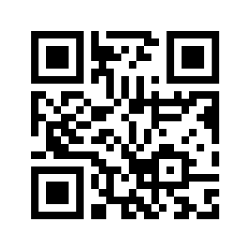
Azure for students
Azure for Students gives worldwide university students (ages 18+) access to more than 25 free Azure services, plus $100 in Azure credit. It also provides students access to downloadable Dev Tools and learning paths in one convenient place:
AZURE EDUCATION HUB
STUDENT ID CARD
$100 Azure
Credit
25+ Free Azure Services
14 Free Developer Tools
Library of Free Learning Paths
Verify as Student
(No credit card required)
PAY NOTHING: Ability to convert to Pay as You go or renew annually
OUTSIDE THE CLASSROOM
Students wanting to learn on their own, participate in hackathons, or build their Imagine Cup project.
INSIDE THE CLASSROOM
Limited to courses like Data Analytics, Machine Learning, Statistics and Probabilistic Modeling with low to moderate resource demands
USAGE SCENARIOS
aka.ms/azure4students
Notes:
Age restrictions apply for certain programs
Azure for Student 18+
Azure for Student Starter 13+ US, 16+ ROW
LinkedIn 16+

Slide 11
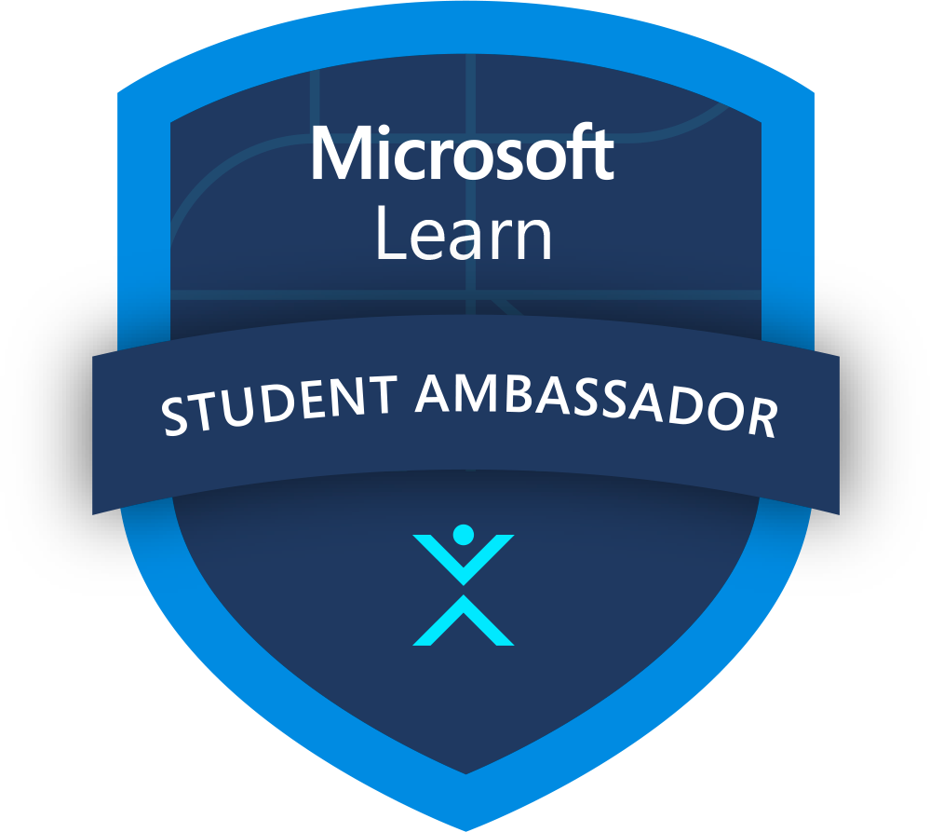
Microsoft Learn Student Ambassadors
Finding your community is more important than ever as classes, events, and even social activities take place virtually. Amplify your impact as a passionate student leader and bring together like-minded peers to build vibrant digital communities across the globe, learn new skills, and solve real-world problems.
Connect with other students who share your passion in focused Leagues and use tech to solve real-world challenges together
Kick-start your career with training and certifications, support for virtual events, and unique access to experts and mentors
Host digital events, offer guidance to other students, and earn recognition that separates your résumé from the pack
Applications are open year-round and selected students are onboarded quarterly!
StudentAmbassadors.com | #MSFTStudentAmbassadors
Notes:
Aligned to one of Microsoft’s key educational offerings
Skilling students with our hands-on learning platform
Continued learning for community after engagements
Preparation for certification
Involved in bigger initiatives within Microsoft
Become a closer partner with Microsoft
Provide feedback, feature requests, and report issues with content
Additional Benefits and Platform Extensions
Certification Exam Vouchers
Free Domain Name
Public Profile and Community Events
Program Nominations
You might find yourself helping fellow students build their coding skills online with Microsoft Learn, organizing a virtual hackathon to solve real-world challenges, earning certifications, or building digital communities—it’s all up to you.

Slide 12



What is Imagine Cup?
Microsoft’s annual global student technology competition that has seen over two million competitors during the last 21 years, the Imagine Cup targets student AI entrepreneurs using technology within the ideation and incubation phase of their entrepreneurial journey.
Imagine Cup 2024 gives student AI entrepreneurs the chance to build out their solution with access to USD2,500 in OpenAI credits and USD1,000 in Azure credits and expert mentorship.
Who can take part?
Student entrepreneurs building with AI who are:
Aged 18 and above
Actively enrolled as a student at an accredited educational institution that grants college/university (or equivalent) degrees
In a team of up to 4 students; team members may come from different academic institutions and from different countries; each competitor may belong to only one team within the competition.
To enter, register at imaginecup.com. More details on eligibility can be found here.

Slide 13
What is the opportunity for students?
Imagine Cup 2024 will target student entrepreneurs building with AI, providing them with an opportunity to:
Take part in a global competition
Submit a valid entry in qualifying to enter Microsoft Founders Hub and receive USD1,000 in Azure credit and USD2,500 in OpenAI credits
Submit a Minimum Viable Product (MVP) with a chance to join top student businesses in the semifinals, receiving technical and start up mentorship to develop their businesses
The Top 3 winning teams will feature at Microsoft Build and receive cash funding to progress their business venture
The winning team will receive 100k and mentorship with Microsoft Chairman and CEO Satya Nadella
The two runners up will receive USD50,000 per team
Ongoing publicity and support through Microsoft Founders Hub

Slide 14
What are the steps in the competition
Oct | Nov | Dec | Jan | Feb | Mar | Apr | May | June
Qualifying
Judging
MVP
Semifinals
Judging
World Championship
Founders Hub L1
Founders Hub L2
Qualifying Oct 16 - Jan 24
MVP Submission Jan 26 - Feb 9
Semifinals Feb 23 - April 12
World Championship April 26 – May 2024 at Microsoft Build

Slide 15
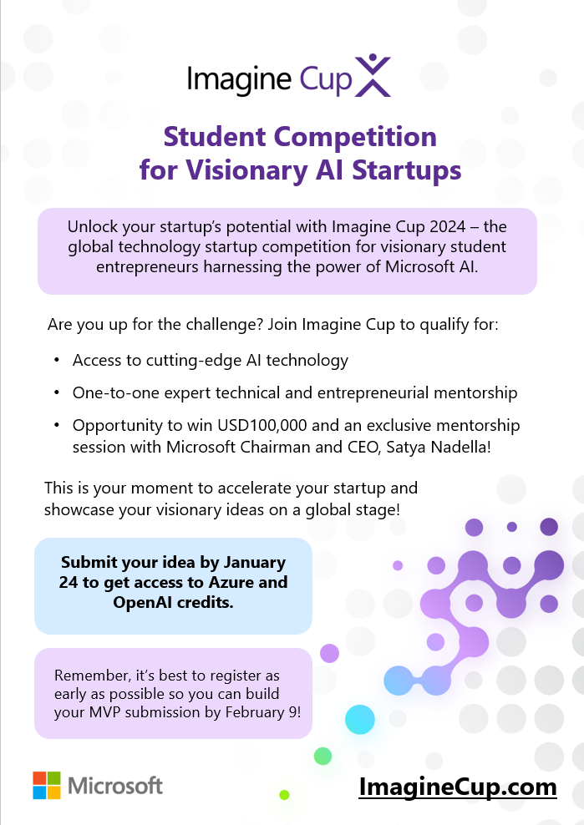
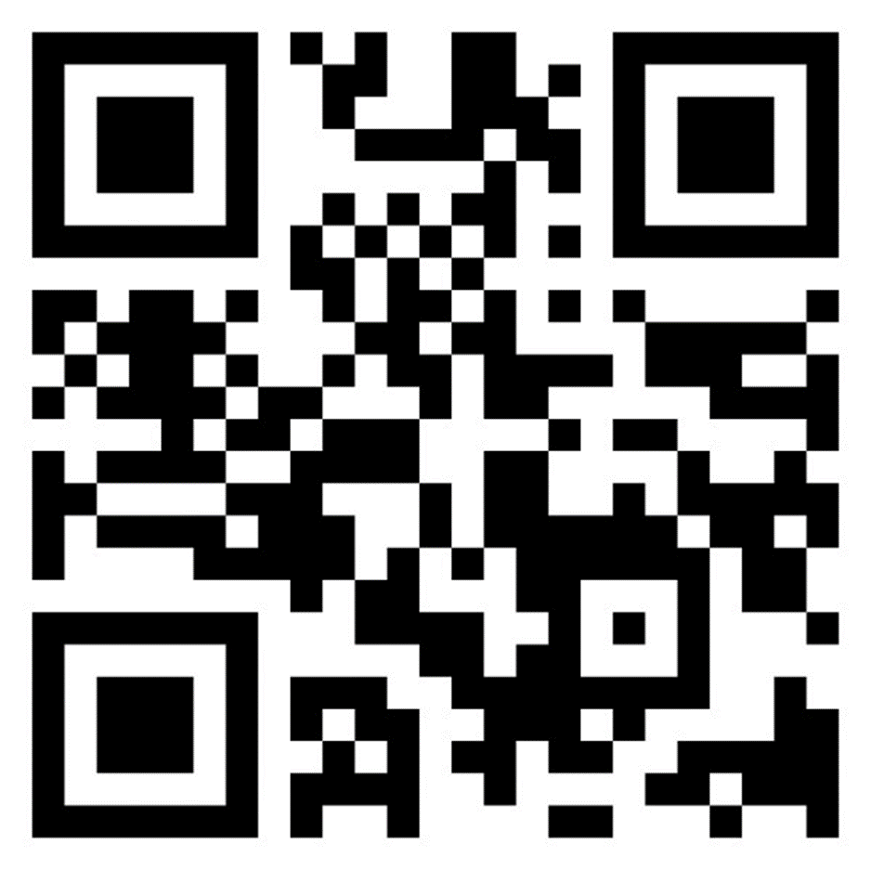
aka.ms/ImagineCupPromo

Slide 16
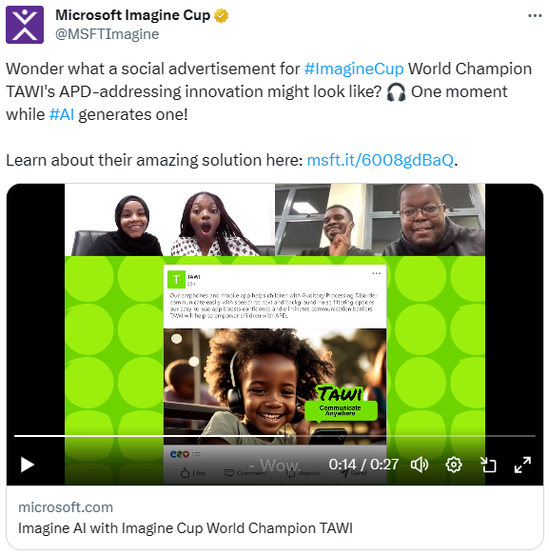
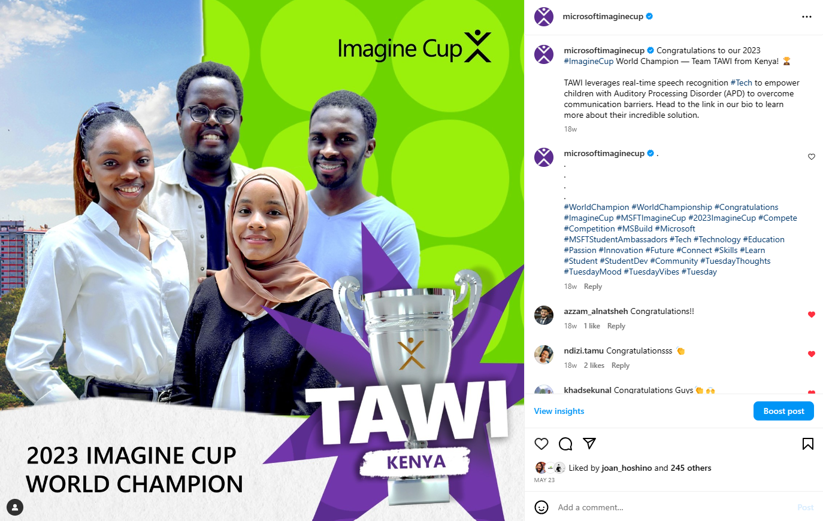





Where can I find the competition on social media?
The Imagine Cup handles (IG, FB, TW) are in the process of being rebranded to be more inclusive of all students.

Slide 17
Useful links
For Students
Microsoft Learn Student Hub Azure for Students
GitHub Codespaces
Internship Learning Path
Microsoft Learn Student Ambassadors
Microsoft Learn for Students
Student Hub
For Faculty
Azure Dev Tools for Teaching
Azure for Education
Azure Lab Services
Educator Developer Blog
GitHub Classroom
Microsoft Learn Educators
Microsoft Learn Educator Center
Microsoft Research Academic Programs
Notes:
Aligned to one of Microsoft’s key educational offerings
Skilling students with our hands-on learning platform
Continued learning for community after engagements
Preparation for certification
Involved in bigger initiatives within Microsoft
Become a closer partner with Microsoft
Provide feedback, feature requests, and report issues with content
Additional Benefits and Platform Extensions
Certification Exam Vouchers
Free Domain Name
Public Profile and Community Events
Program Nominations
You might find yourself helping fellow students build their coding skills online with Microsoft Learn, organizing a virtual hackathon to solve real-world challenges, earning certifications, or building digital communities—it’s all up to you.

